Slide 1
Management
PhD in Business Economics
Luis D. Torres, PhD.

Slide 2
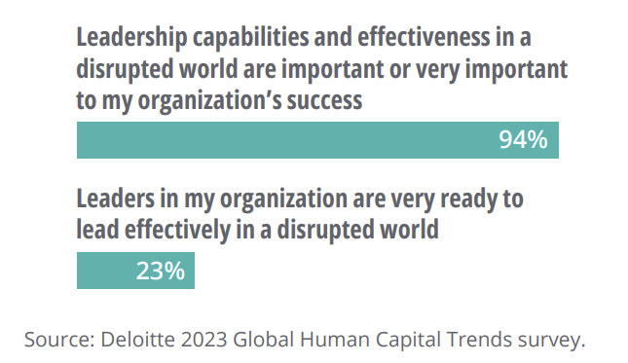
Agenda
First part: Strategic Management
Intro to Strategy
Building competitive advantage – the resource base view and its evolution
Second part: Leadership
The Landscape of Leadership Theories
Leadership Stupidity and Hubris

Slide 3
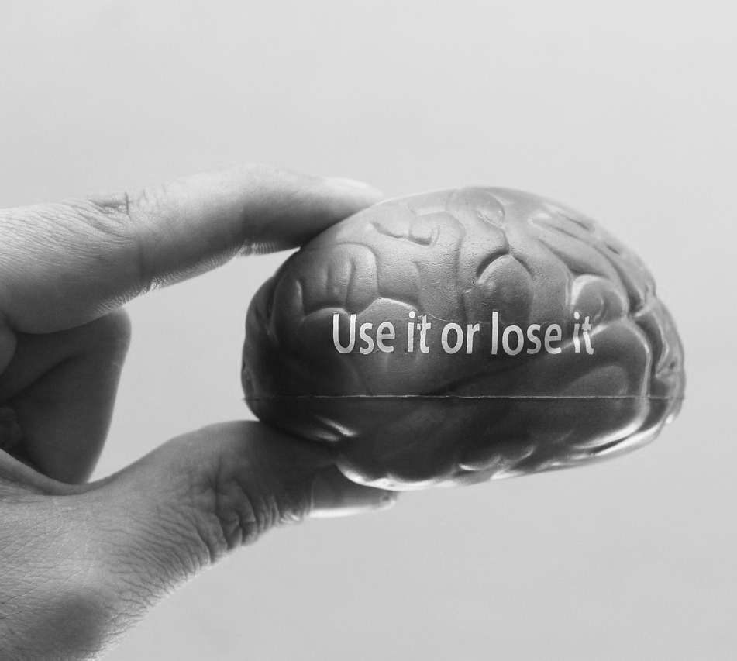
Let’s think about competitive advantage
Think of a company you prefer buying something, which company would that be? Which product do you buy from them?
Now, think of other companies you could buy a similar or the same product, which companies are those?
Then, tell me the difference between the company you prefer and the others.

Slide 4

What is competitive advantage?
In simple terms, a competitive advantage is an attribute that allows a company to outperform its competitors
It is the unique feature that sets a business apart in the market enabling it to earn bigger profits and gain more market share:
Unique to your organisation
Valuable to your clients
Source of competitive advantage are several including price discrimination, lower cost, superior product (differentiation), innovation, human capital, etc.
Source: https://online.hbs.edu/blog/post/sources-of-competitive-advantage

Slide 5
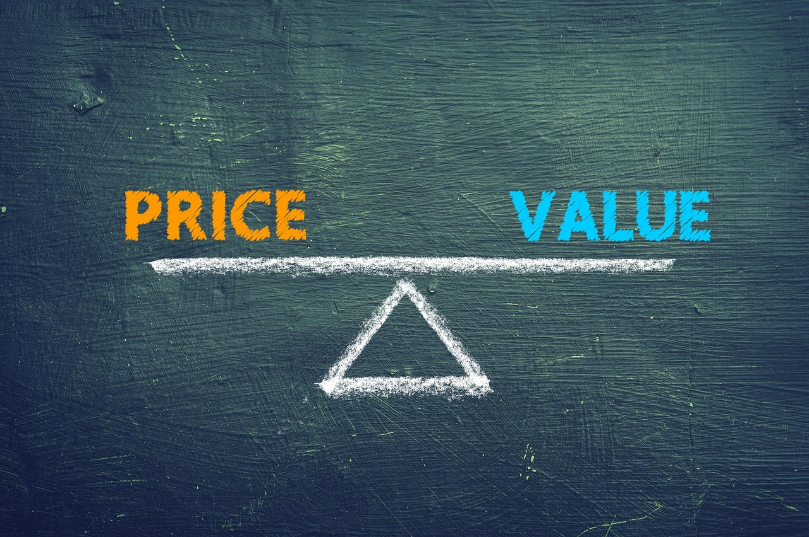
What is value?
Value and value creation are the foundation of competitive advantage.
When you buy a product or a service, what is value for you?
Who are we creating value for?
What is value for those groups?

Slide 6
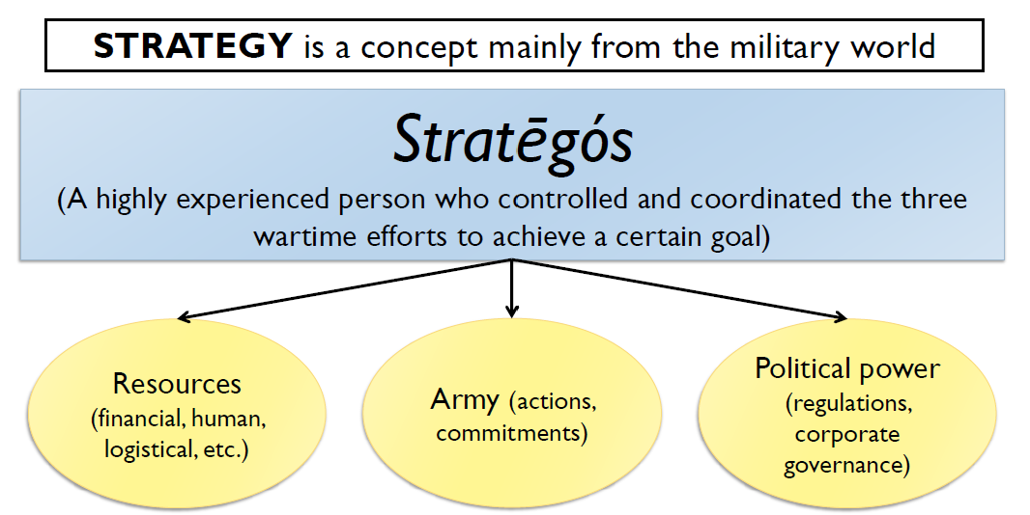
Where does the (Western) concept of strategy come from?

Slide 7
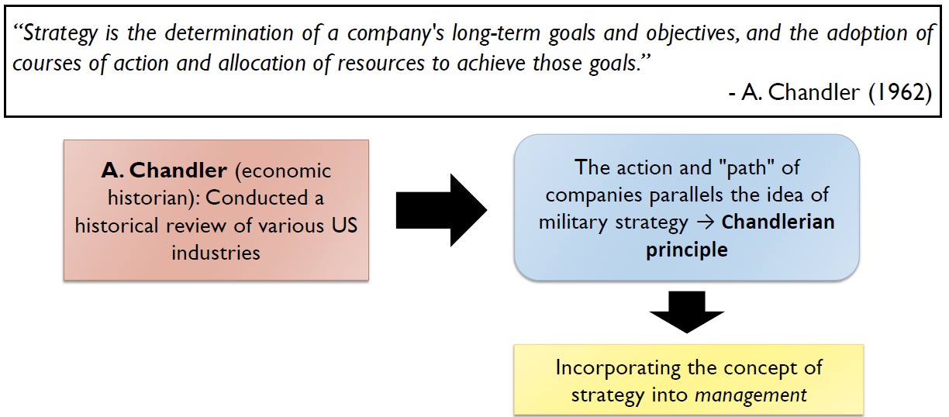
From the military to management: Strategy in the business world

Slide 8
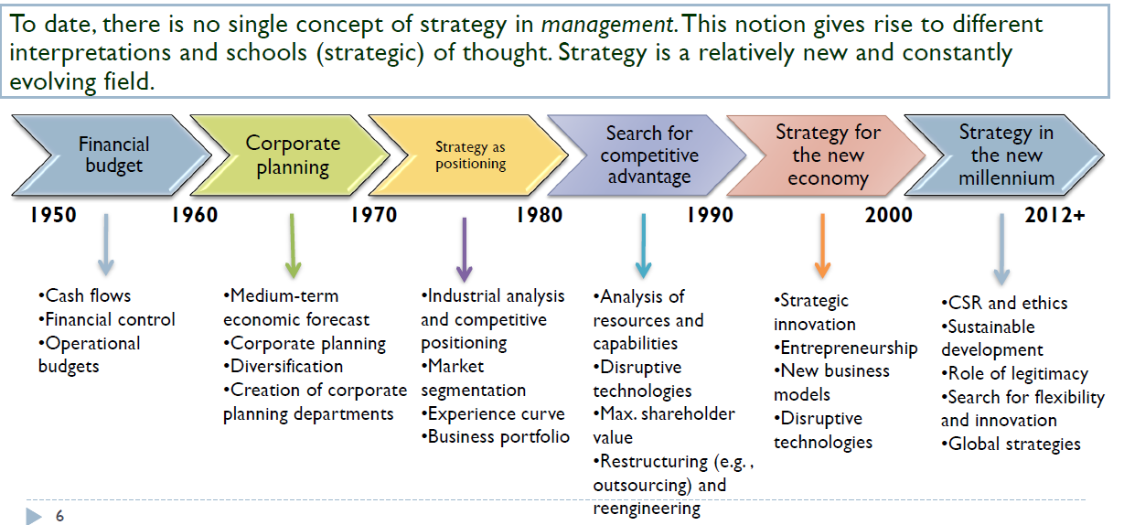
Beginning to conceptualize what strategy is: History in context

Slide 9
What about today?
Ecosystems
Digital transformation
Sustainability, ESG, and grand challenges
Non-market strategy and geopolitical fragmentation
Behavioural strategy
Organisational resilience
Although the basic elements of Strategy are relevant in most circumstances, how they play out precisely is likely to differ according to organisational contexts:
Start-ups and small businesses
Family businesses
Multinational corporations
Public sector and not-for-profits
…

Slide 10
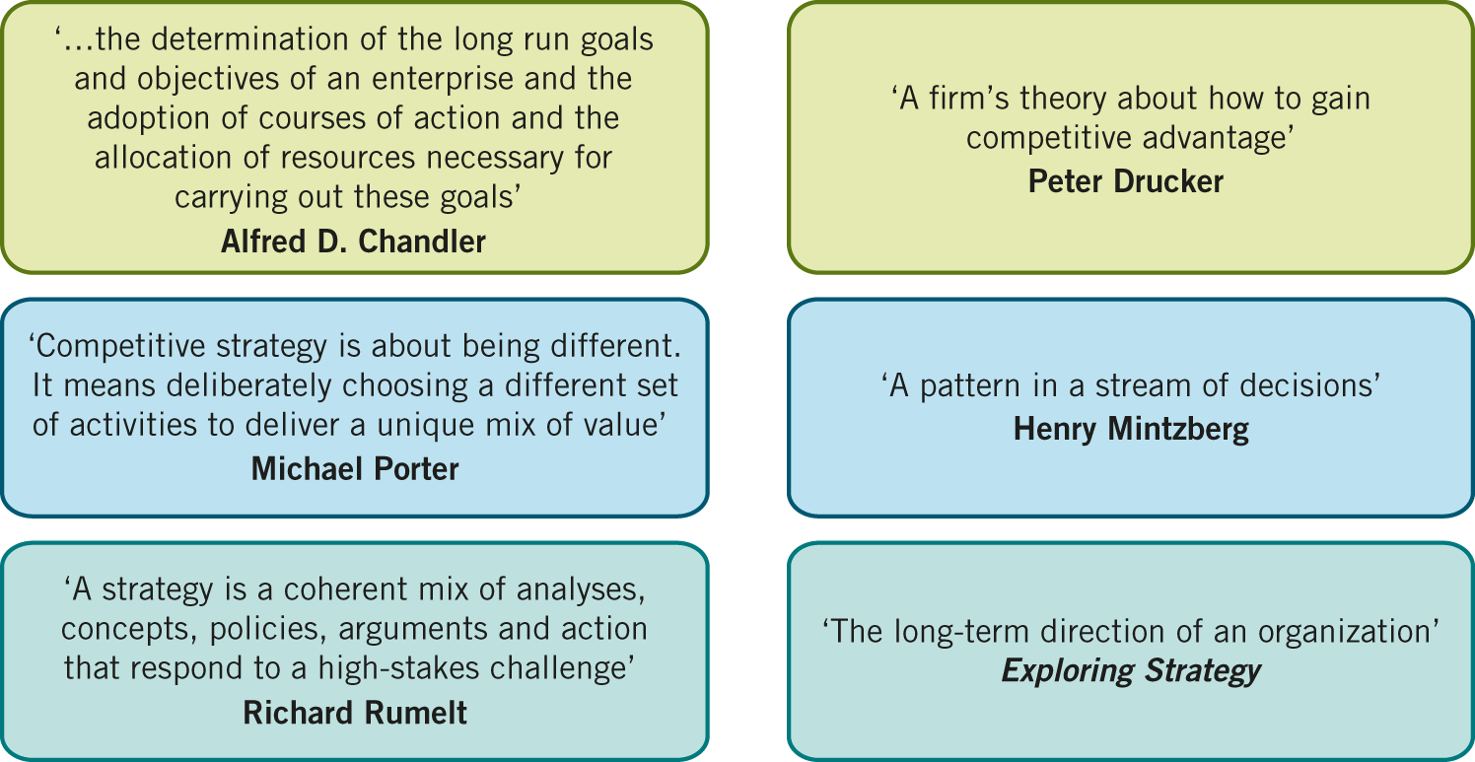
Towards a definition of strategy
The long-term direction of an organisation

Slide 11
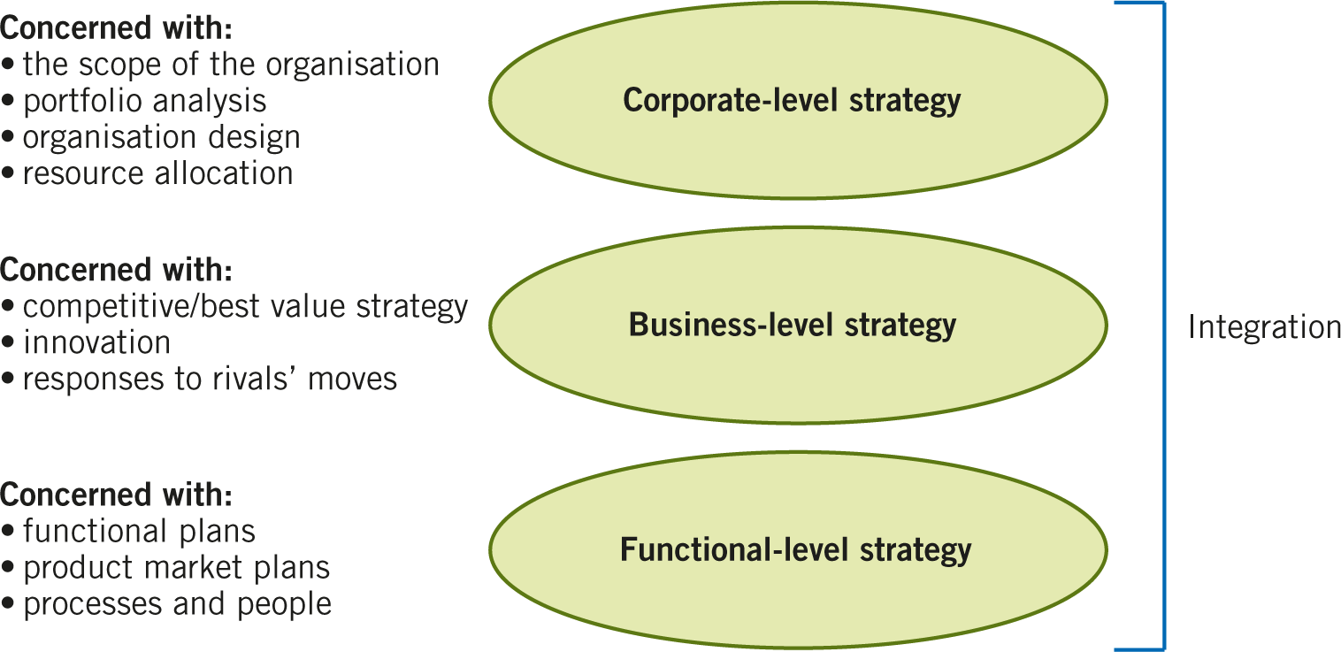
Levels of Strategy
Operational strategy
Sometime the functional-level strategy is separated into functional and operational adding an additional level. However, we will study operational strategy as a function.

Slide 12
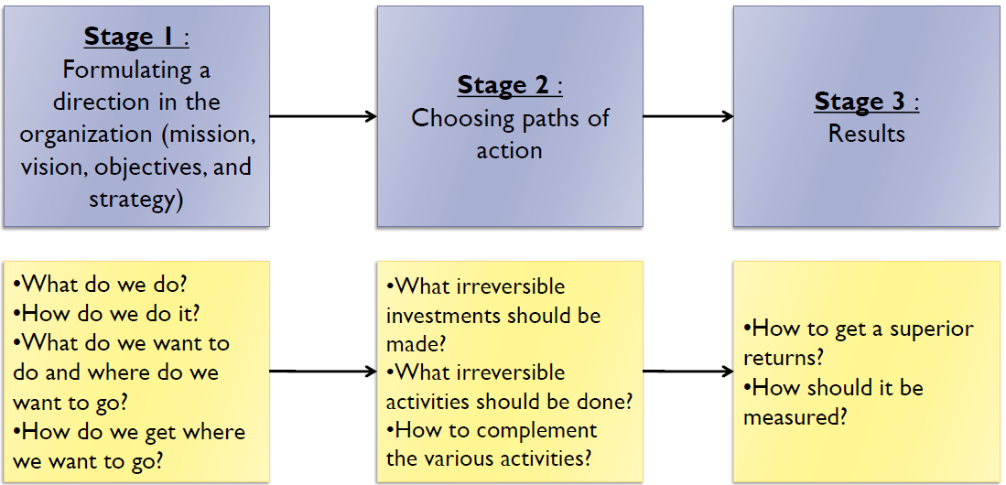
The strategic formulation process

Slide 13
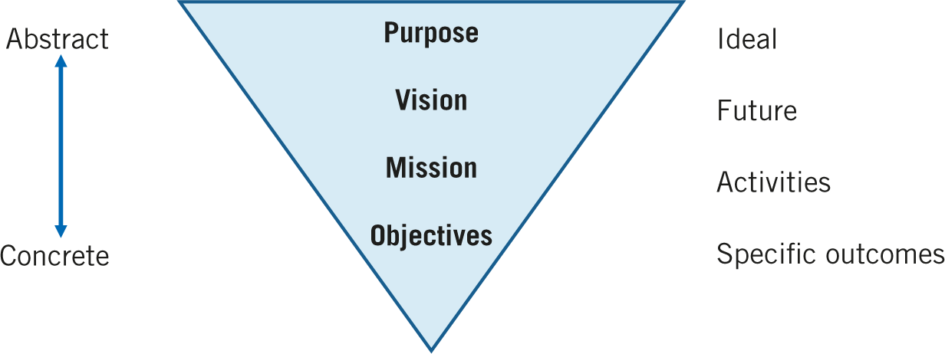
Strategic hierarchy
Purpose
Vision
Mission
Values
Objectives
Ideal: Why do we do what we do?
Future: What do we want to achieve?
Activities: What does the company do?
Principles: What principles guide our actions?
Outcomes: What specific results we want to achieve?
Strategy statement
Policies (rules or action guides)
Programmes (sequence of necessary actions)
Budgets (strategy quantification)

Slide 14
Basic framework for strategic analysis
The internal organisation
The external environment
Goals and values
Resources and capabilities
Structure, processes and systems
Macro-level
Industry or sector
Competitors
Customers
Suppliers
Strategy
Fit
The objective of a business strategy is to determine how the company will manage its resources within its business environment (the industry) to meet its long-term goals , and how it will organize itself internally to implement that strategy.

Slide 15
Foundations of Competitive Advantage
Resources
Capabilities
Resources are the assets that organisations have or can call upon (e.g. from partners or suppliers), that is ‘what we have ’
Resources are not productive on their own and can only be a source of competitive advantage if they are used by firms to perform their activities
How can resources and capabilities provide sustainable competitive advantage?
A VRIO analysis helps to evaluate if, how and to what extent an organisation or company has resources and capabilities that are
Capabilities (sometimes referred to as competences) are the actions through which resources are used/deployed, that is ‘what we do well’ .
They usually refer to the way organisational competences are organised.
The organisational and strategic routines by which firms achieve new resource configurations. Routines refer to the specific processes.
Barney (1991)

Slide 16
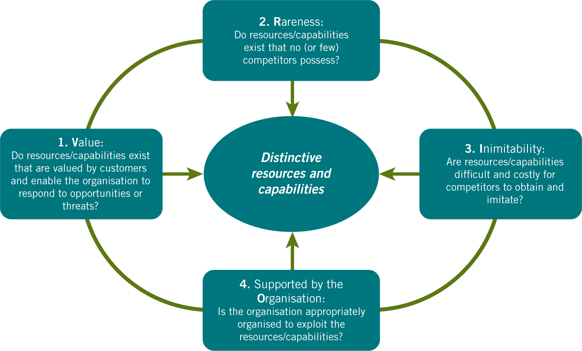
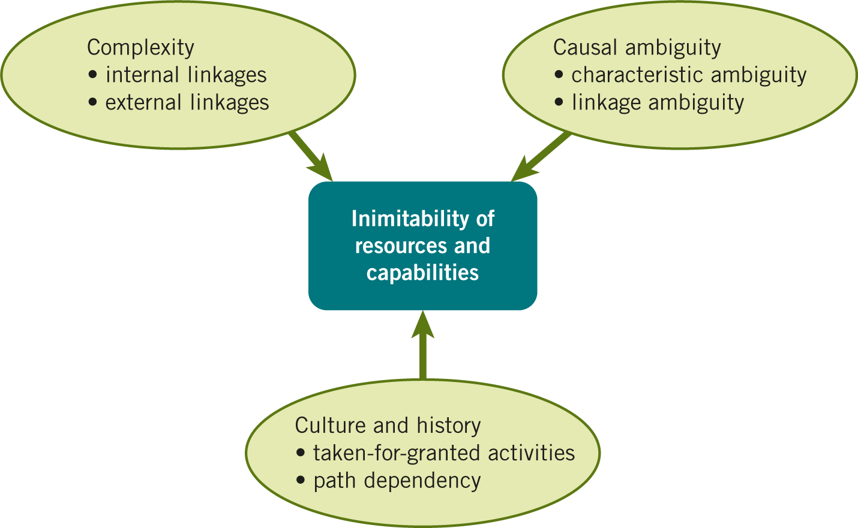
The VRIO framework and criteria for inimitability
How does Reed & DeFillippi (1990)’s paper build directly on Barney’s "Imitability" criterion?

Slide 17
Capabilities and Capital
RBV can sometimes treat resources as static, physical, or purely economic things.
Dynamic capabilities vs. ordinary ("zero-level") capabilities.
Ordinary capabilities are those needed for an organisation to meet the necessary requirements to compete in a given market and achieve parity with competitors in that market
Dynamic capabilities are an organisation’s ability to integrate, build, and reconfigure internal and external resources and capabilities to address rapidly changing environments
Three generic types of dynamic capabilities:
Sensing (e.g. market intelligence systems, trend forecasting and scenario planning, customer insight generation)
Seizing (e.g. business model innovation, strategic partnerships and alliances, product portfolio redesign)
Reconfiguring (e.g. organisational restructuring, change management, digital transformation)
(Teece, Pisano, and Shuen, 1997)
Winter (2003)

Slide 18
Capabilities and Capital
The most valuable and hard-to-imitate resources a firm has are actually social and intellectual.
Two key forms of capital:
Intellectual capital: Defined as the knowledge and knowing capability of a social collectivity (like an organization)
Social capital: Defined as the sum of the actual and potential resources embedded within, available through, and derived from the network of relationships possessed by an individual or social unit.
It shifts the focus of competitive advantage from what a firm owns to how a firm connects and creates knowledge.
If we apply Barney’s VRIO framework to Nahapiet & Ghoshal, which dimension of social capital (structural, relational, or cognitive) is the most difficult for a competitor to imitate?
A firm’s dynamic capability to combine and exchange new knowledge relies heavily on its existing social capital (e.g., whether the engineers actually trust each other enough to share ideas).
Nahapiet & Ghoshal (1998)

Slide 19
The role of the Top Management team
Upper Echelons Theory
The organisation is a reflection of its top managers.
If you want to understand why organizations do the things they do, or why they perform the way they do, you must look at the people at the top.
Bounded rationality: Because no human can perfectly process all available information, executives must filter the world through their own cognitive base and values.
Before this paper, strategy research largely assumed that firms acted as hyper-rational, profit-maximising entities (often ignoring the human element) or focused solely on external industry forces.
Does the manager shape the firm, or does the firm select a manager who already fits its desired trajectory?
Hambrick & Mason (1984)

Slide 20
The role of the Top Management team
Ideological Leadership
Instrumental Leadership
Integrative Public Leadership
Shared Leadership
Charismatic
Leadership
The Big Six:
Transformational
Charismatic
Strategic
Leadership and Diversity,
Participative/Shared
Trait approaches.
Pragmatic Leadership
TFL
Servant Leadership
Laissez faire
Empowering Leadership
Spiritual Leadership
Transactional Leadership
Authentic Leadership
Ethical Leadership
Meuser et al. (2016)

Slide 21
Classic leadership theories
Trait approaches
Skill approaches
Behavioural approaches
Traits
Cognition
Knowledge, skills & abilities
Behaviours
Emotions
Contingent/situational/relational approaches
Context / followers

Slide 22

What is it missing in this theoretical mess?
Do we need leadership all the time? why?
Contingent/situational approaches talk about “when”, but from the perspective of when one leadership style is more effective than other.
We will consider “when” from the perspective of the task at hand.

Slide 23
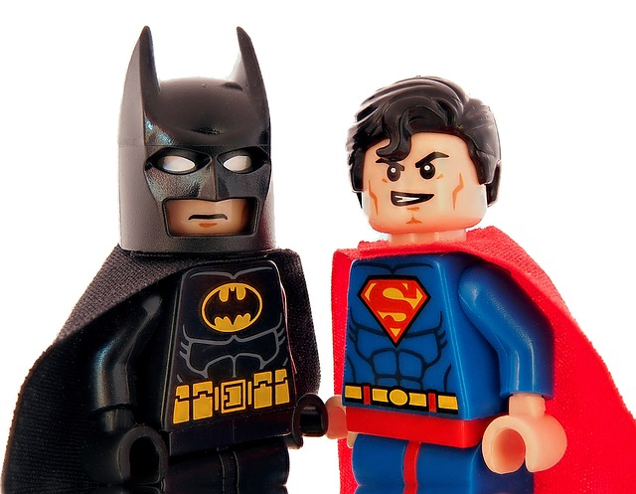
The “when” matters
The person
(traits and skills)
The actions
(behaviours)
The task/challenge
Why superman and batman are considered superheroes?

Slide 24
Critical perspectives
The stupidity paradox: The very thing that makes a company efficient on a Tuesday (nobody questioning the boss) is the exact thing that bankrupts it five years later.
Functional stupidity: An absence of reflexivity, substantive reasoning, and justification.
Smart people are hired but quickly learn that asking: "why are we doing this?" or challenging the status quo is frowned upon. They put their heads down, follow the rules, and speak in corporate jargon.
It works in the short term. It eliminates the friction of constant debate. It creates harmony, smooths over daily operations, helps employees advance their careers (by not rocking the boat), and provides a comforting sense of certainty.
In the long term, it traps the organisation in problematic, myopic patterns. When disaster looms, no one raises the alarm because the culture has marginalised doubt and blocked communicative action.
Alvesson & Spicer (2012)

Slide 25
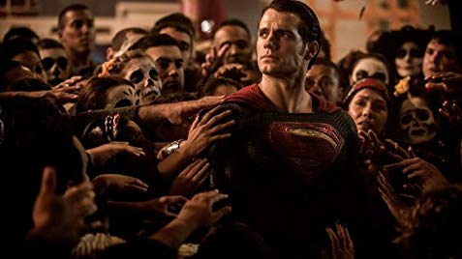
Critical perspectives
We tend to idealise the figure of leadership
As a result, we put expectations and give power to those who hold positions of leadership.
Then, we try to learn from those we hold as “great leaders” (in many cases still those in formal positions of leadership).
And yet leaders keep failing, disappointing, etc.

Slide 26
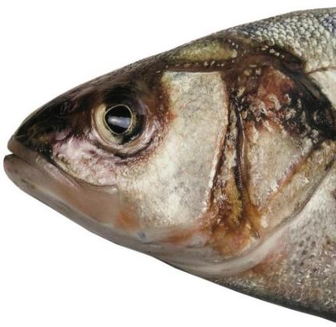
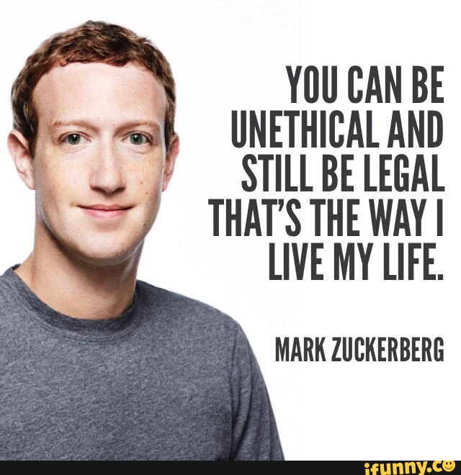
Critical perspectives
A fish rots from the head first…
March 5, 2004

Slide 27
Wrapping-up
Which of these paradigms do you think offers the most promising avenue for future research? Where are the gaps?

